Slide 1
Notes:
You have been chosen to help end the Zombie Apocalypse! It’s your job to create a drug that will cure the dysfunctional parts of the zombie brain. You must use your expert knowledge of neurotransmission and neuroanatomy to create a cure using agonists and antagonists for the neurochemicals: dopamine, serotonin, GABA, glutamate, and norepinephrine. When you are finished you will present your cure to your classmates for feedback. Time is of the essence. Over a million people have already died and more become infected every day!
Let’s start by watching this short video!

Slide 2
Notes:
Please show the following YouTube video to introduce the activity and provide background information for students. Click here if embedded link does not show: https://www.youtube.com/watch?v=y42jrDVge9Q

Slide 3
Notes:
The brain is made up of many regions. We will touch on a few today that will be important for the activity we do at the end of the lesson. Understanding the functions of these brain regions will be critical for executing the class activity.
Brain regions of interest and their functions:
Frontal Lobe: planning, reasoning, speech, movement, and problem-solving
Amygdala: Primitive emotion center, fuels fear and rage
Anterior Cingulate Cortex: slows communication from the amygdala to the frontal lobe
Cerebellum: coordination and balance
Basal Ganglia: motor control and fluidity of movements
Ventromedial Hypothalamus: modulates eating behavior by sending hunger and satiety signals
What do these brain regions have to do with Zombie behavior?
Frontal Lobe: The frontal lobe is critical for executive functions such as reasoning, planning, and problem-solving. Zombies can see and sense us, but they have a hard time using executive functions when interacting with humans. It is clear zombies lack a functional frontal lobe due to their impulsive nature and lack of consideration for the consequences of their actions. In addition, zombies cannot plan complex actions and therefore get stuck when it comes to opening a door or a window.
Amygdala: Because zombies have a dysfunctional frontal lobe, the amygdala, the primitive emotion center of the brain responsible for our “fight or flight” response, has free reign. Usually, the frontal lobe sends signals to the amygdala to regulate its activity. Without those regulatory signals, the amygdala is hyperactive. A hyperactive amygdala impairs the zombie’s ability to think rationally and make wise decisions, which can result in intense feelings of fear, rage, and aggression. This drives a zombie’s need to attack!
Dr. Schlozman, the author of Zombie Autopsies and host of the YouTube video students watched, notes that crocodiles are also mostly driven by their amygdala. Researchers have found if you take out the amygdala of the crocodile, the animal is significantly less likely to attack and retreat.
Anterior Cingulate Cortex: Communication from the frontal lobe to the amygdala dampens amygdala responses causing you to be more rational. In contrast, communication from the amygdala to the frontal lobe dampens frontal lobe activity causing you to behave impulsively. The cingulate gyrus governs the communication from the amygdala to the frontal lobe. The anterior portion of this gyrus slows the communication signals from the amygdala to the frontal lobe and the posterior portion speeds these signals up. When your amygdala responds to a threat in your environment causing a fear response, the anterior cingulate cortex activates to slow communication to the frontal lobe, allowing you to think the situation through before acting on impulse.
Cerebellum: We know that zombies are capable of hunting humans. However, their movements are off balance and unsteady. They have a stiff, wide-legged walk and constantly look like they are going to teeter over. This must be, in part, due to a dysfunctional cerebellum.
Basal ganglia: The basal ganglia is implicated in motor control and fluidity of movement. Our basal ganglia allows us to do simple tasks, like picking up a glass, and more complicated tasks, like driving a car. Ultimately, the basal ganglia allows us to put movements together to achieve a goal. As we discussed above, zombies lack the ability to move properly. They are clumsy and unable to execute simple motor tasks. Therefore, they must have an abnormality of the basal ganglia.
Ventromedial hypothalamus: The ventromedial hypothalamus is a specific nucleus of the hypothalamus. It is responsible for sending out hunger and satiety signals to regulate how much we eat. Zombies are constantly hungry, always looking for a human to prey on. Therefore, the ventromedial hypothalamus must not be functioning properly, making the zombie insatiable.

Slide 4
Notes:
Cells within the nervous system are called neurons. Neurons are the basic working units in the brain designed to communicate with each other to carry out all brain functions. They are responsible for communication both within and between brain regions. We have approximately 86 billion neurons in our brains!
A neuron is made up of three main parts: the dendrites, cell body, and axon. Dendrites receive information from other neurons while axons send information to other neurons via electrical signals. The cell body houses the nucleus and cytoplasm.

Slide 5
Notes:
The contact point between two neurons where communication occurs is called the synapse. When a neuron wants to send information to another neuron, it conducts an electrical impulse down the axon. Something called the myelin sheath wraps around the axon, insulating the axon and allowing the electrical impulses to travel faster. Once the signal reaches the end of the axon, an area called the nerve terminal, chemical messengers called neurotransmitters are released. Neurotransmitters travel across the synapse and bind to receptors on the receiving neuron’s dendrites.
Specific neurotransmitters bind to specific receptors, similar to a lock and key. Binding of the neurotransmitter to its appropriate receptor acts like an on/off switch for the receiving neuron. Again, optimal neurotransmission/neuronal communication is critical for proper brain functioning. Breakdown of communication between neurons within a brain region can cause dysfunction of that particular brain region.

Slide 6
Notes:
There are many types of neurotransmitters that can have a variety of effects in a variety of different brain regions. We will touch on a few that will be used in this lesson plan.
Question:
Has anyone heard of any of these neurotransmitters or have any idea what they do in the brain?

Slide 7
Notes:
Notes:
Glutamate is the main excitatory neurotransmitter in the brain. Upon binding to receptors, glutamate excites the receiving neuron and encourages neuronal activity. Glutamate is thought to enhance brain activity.

Slide 8
Notes:
Notes:
GABA inhibits or silences neurons when binding to their receptors. An influx of GABA into a particular brain region can quiet the activity of that brain region.

Slide 9
Notes:
Notes:
Dopamine is a critical neurotransmitter to signaling pathways in the brain that govern movement. A deficiency in dopamine can cause symptoms such as muscle rigidity, tremors, and difficulty making coordinated, fluid movements. Dopamine also acts in the hypothalamus to help regulate hormone secretion.
Question:
Can anyone think of a common disease that causes dysregulation or dysfunction of movement that dopamine may play a role in?
Answer: Parkinson’s Disease

Slide 10
Notes:
Notes:
Serotonin levels increase in the amygdala in response to fear. Therefore, when you come into contact with a threat in your environment, an influx of serotonin occurs in the amygdala to promote an emotional response.
Serotonin signaling also has implications for satiety in the hypothalamus. It is thought that activation of certain serotonin receptors in the hypothalamus promotes satiety.

Slide 11
Notes:
Notes: Norepinephrine is known to be involved in behaviors such as arousal and sleep.
Interestingly, norepinephrine is also released while under stress. High levels of norepinephrine in the prefrontal cortex can cause dysregulation of signaling systems and impair functioning of this brain region.
Brains of patients with post-traumatic stress disorder show that the norepinephrine released during stress continues to remain at high levels in the prefrontal cortex for an extended amount of time.
Question: Why might this be detrimental to post-traumatic stress patients?
Answer: Patients stay in a state of high stress/high arousal.

Slide 12
Notes:
Many drugs act as agonists or antagonists at certain receptor sites.
An agonist is a chemical that binds to a receptor, mimicking the action of the neurotransmitter that binds to that receptor site.
In contrast, an antagonist neurochemical binds to a receptor, blocking the receptor and preventing the appropriate neurotransmitter from binding at that site (preventing the action of the neurotransmitter).
Agonists are used to promote the intended action of the neurotransmitter at its receptor site, and antagonists are used to block the action.

Slide 13
Notes:
Split students into groups.
Pass out Skittles in a plastic cup and hand out the brain diagram to each group.
The Skittles will serve as neurotransmitter agonists or antagonists. Students will place the Skittles in the different brain regions, indicating they would like the drug to send that specific neurotransmitter agonist or antagonist to that particular brain region. The students do not have to use all the Skittles.

Slide 16
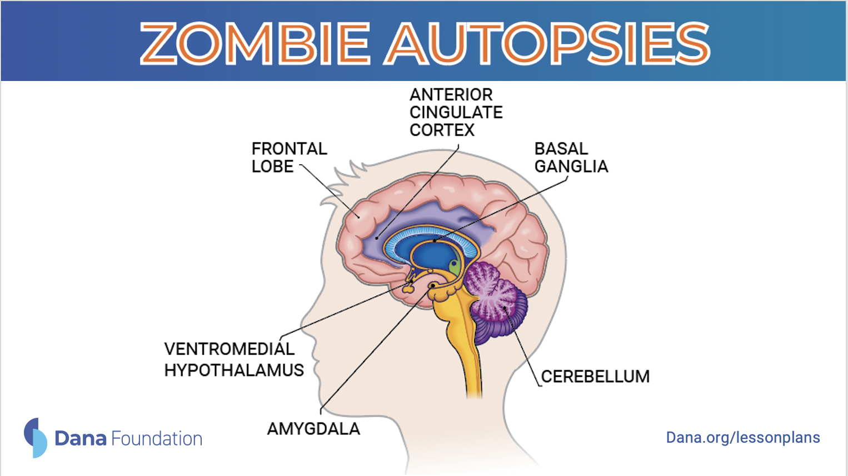
Notes:
Use this slide during the group presentations. Students can use this visual aid when explaining the actions of their drug in the brain.

